Slide 1


Please write title, subtitle and speaker name in all capital letters
Operating Elasticsearch in Kubernetes
MIKKEL LARSEN @mikkeloscar
OLIVER TROSIEN
@otrosien
2019-04-02

Slide 2


WHO ARE WE?
Oliver Core Search Services Elasticsearch
Mikkel Cloud Infrastructure

Slide 3




“EUROPE’S LEADING ONLINE FASHION PLATFORM”

Slide 4
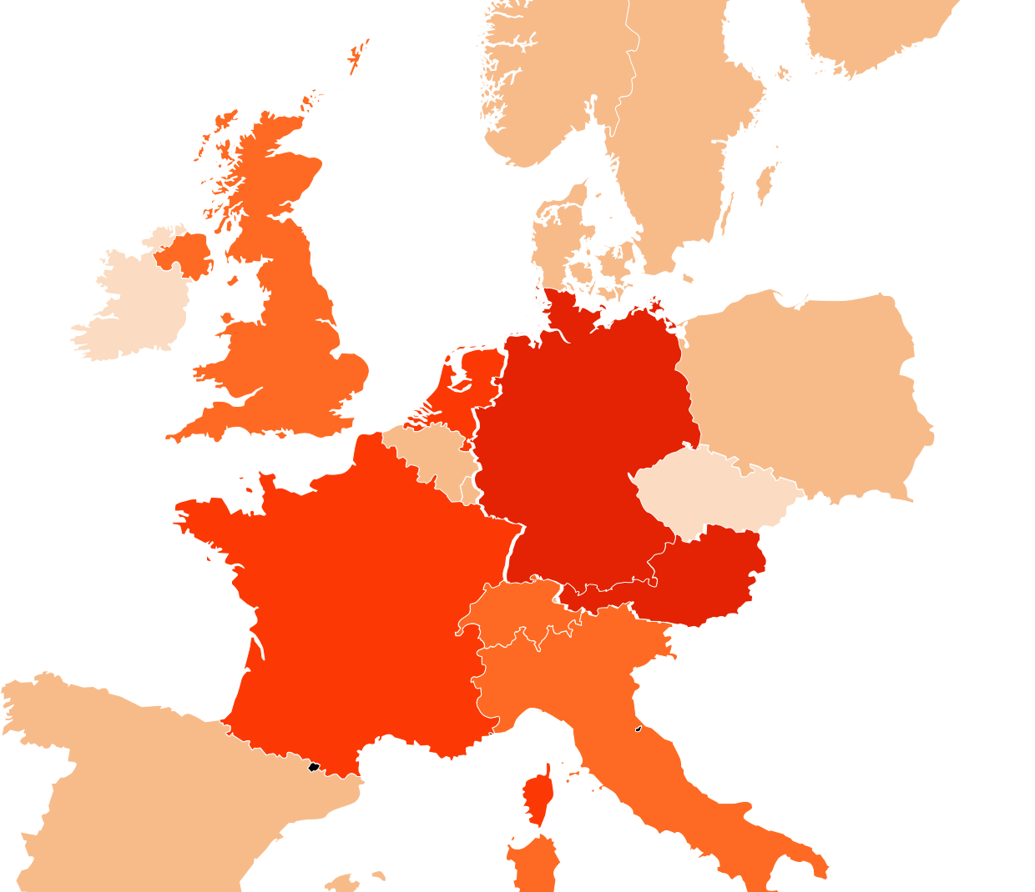
WE BRING FASHION TO PEOPLE IN 17 COUNTRIES
17 markets
7 fulfillment centers
26 million active customers
5.4 billion € revenue 2018
250 million visits per month
15,000 employees in Europe
Notes:
2008/2009: Germany, Austria
2010: Netherlands, France
2011: Italy, UK, Switzerland
2012/2013: Sweden, Belgium, Spain, Denmark, Finland, Poland, Norway, Luxembourg
2018: Czech Republic, Ireland

Slide 5


SEARCH @ ZALANDO
45% Mobile Traffic
300k+ Products
per country
~2000
Brands
12K QPS
~700
Categories
8K
Updates/s
Notes:
The Search Department
Don’t repeat numbers
Active customers
Other interesting metrics
Department size (headcount)

Slide 6


DATA INGESTION
Stock availability
Fashion Tags
Scoring
Article Content
Elasticsearch
Pricing & Campaigns
Image Tags
Color Enrichment
Kafka / Nakadi *
* nakadi.io
Notes:
Massive denormalisation -> high update rate

Slide 7
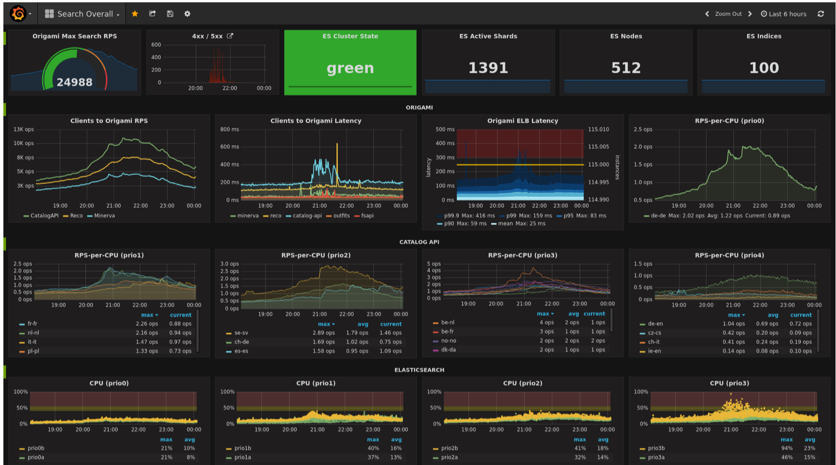
Notes:
No matter how

Slide 8



KUBERNETES @ ZALANDO
Please write the title in all capital letters
Use bullet points to summarize information rather than writing long paragraphs in the text box
Default Deployment Target
114
clusters
1400~
nodes
Node Autoscaling
Since
Oct 2016
From v1.4 to v1.12

Slide 9


Elasticsearch 2.500 vCPUs
1 TB RAM
Elasticsearch in Kubernetes

Slide 10

RUNNING ELASTICSEARCH IN KUBERNETES
Safe automatic updates
(Including Kubernetes cluster updates)
Advanced auto-scaling for cost efficiency
Notes:
Mention existing alternatives that we have looked at.
upmc-enterprises/elasticsearch-operator

Slide 11
UPDATING ELASTICSEARCH (STATEFULSET)
Please write the title in all capital letters
Use bullet points to summarize information rather than writing long paragraphs in the text box
1) PreStop Hook (bash script)
Exclude node in ES
Wait for node to drain (up to 1h)
Data is moved to existing nodes
Node
Node
ES Pod
ES Pod
ready
ready
Node
Node
ES Pod
ES Pod
ES Pod
2) PostStart Hook (bash script)
Remove all excludes
Let ES rebalance from existing nodes
ES Pod
terminating
ready
ready
draining
Notes:
Mention terminology overlap: ES Pod == ES Node, ES Cluster = Master + Data Nodes. Replica = Pod Replica vs Index Replica
Operator sets Pod Disruption Budget 0
TerminationGracePeriodSeconds: 3600 (1h) https://github.com/helm/charts/blob/9bf7799e7f91d2e1142be8d6724c8aa9cc7ed8a9/incubator/elasticsearch/values.yaml#L101
Hooks are “bound-to-succeed”
Visualize data moving.

Slide 12
ELASTICSEARCH DATA SETS
Please write the title in all capital letters
Use bullet points to summarize information rather than writing long paragraphs in the text box
apiVersion: zalando.org/v1 kind: ElasticsearchDataSet metadata: name: test-cluster spec: scaling:
{...}
replicas: 3 template: # PodTemplate {...} volumeClaimTemplates:
{...}
github.com/zalando-incubator/es-operator
Notes:
We do not try to abstract podTemplates or volumeClaimTemplates
Scaling will be explained later

Slide 13
ELASTICSEARCH DATA SETS
Please write the title in all capital letters
Use bullet points to summarize information rather than writing long paragraphs in the text box
ES
Operator
ES Data
ES Data
ES Data
ES Data
ES Cluster
ES Data
ES Data
ES Master
ES Data
ES Master
ES Data
ES Data
ES Master
github.com/zalando-incubator/es-operator
Notes:
We do not try to abstract podTemplates or volumeClaimTemplates
Scaling will be explained later
ES Node ^= Pod

Slide 14
UPDATING ELASTICSEARCH (OPERATOR)
Please write the title in all capital letters
Use bullet points to summarize information rather than writing long paragraphs in the text box
Node
Node
ES Pod
ES Pod
ready
ready
ES Service
1) Scale out by 1
2) Drain node
draining
Node
Node
ES Pod
ES Pod
ES Pod
ES Pod
ES
Operator
3) Delete Pod
ready
ready
draining
github.com/zalando-incubator/es-operator
Notes:
Operator sets Pod Disruption Budget 0

Slide 15
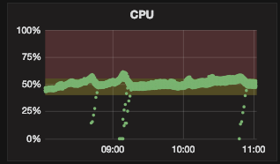
SCALING UP ELASTICSEARCH (1)
Please write the title in all capital letters
Use bullet points to summarize information rather than writing long paragraphs in the text box
METRICS
Thresholds
CPU
Duration
Cooldown
Boundaries
Max # Pod replicas
Node
ES Pod
2 shards
Node
Node
ES Pod
Node
2 shards
ES Pod
Node
ES Pod
2 shards
3 shards
ES Pod
Node
Node
2 shards
ES Pod
6 shards
Node
ES Pod
Node
ES Pod
2 shards
ES Pod
3 shards
Node
2 shards
ES Pod
Node
2 shards
ready
ES Pod
2 shards
ready
Node
ES Pod
ready
ready
1 shard
ready
ready
ready
ready
ready
ready
ready
ready
Increase pod replicas
Notes:
Scaling Parameters
Node replicas
Index replicas
CPU graph
Hands-off when cluster is not green
Not HPA

Slide 16
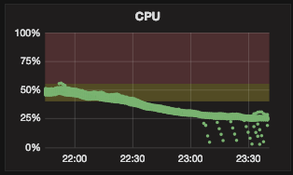
SCALING DOWN ELASTICSEARCH
Please write the title in all capital letters
Use bullet points to summarize information rather than writing long paragraphs in the text box
DON’T OPERATE WHEN CLUSTER IS NOT GREEN!
METRICS
Thresholds
CPU
Duration
Cooldown
Boundaries
Min # Replica
Max # Shards per node
Max disk usage (%)
Node
Node
ES Pod
2 shards
Node
Node
ES Pod
Node
2 shards
ES Pod
ES Pod
6 shards
2 shards
ES Pod
Node
Node
3 shards
ES Pod
Node
ES Pod
2 shards
2 shards
ES Pod
Node
Node
3 shards
ES Pod
2 shards
ES Pod
Node
2 shards
ready
ES Pod
2 shards
ready
ready
Node
ready
ready
ES Pod
1 shard
ready
ready
ready
ready
ready
ready
ready
Decrease Pod replicas
Notes:
Scaling Parameters
Node replicas
Index replicas
CPU graph
Hands-off when cluster is not green

Slide 17
SCALING UP ELASTICSEARCH (2)
Please write the title in all capital letters
Use bullet points to summarize information rather than writing long paragraphs in the text box
METRICS
Thresholds
CPU
Duration
Cooldown
Boundaries
Min # Shards per node
Max # Pod replicas
Node
Node
Node
ES Pod
ES Pod
2 shards
2 shards
ES Pod
Node
Node
3 shards
Node
ES Pod
ES Pod
2 shards
1 shard
Node
ES Pod
Node
ES Pod
2 shards
1 shard
ES Pod
Node
2 shards
ES Pod
Node
1 shard
ES Pod
1 shard
ready
ready
ready
ready
ready
ready
ready
ready
ready
ready
Increase index replicas
Notes:
Scaling Parameters
Node replicas
Index replicas
CPU graph
Hands-off when cluster is not green

Slide 18

DEMO
Please write the title in all capital letters
Use bullet points to summarize information rather than writing long paragraphs in the text box

Slide 19
OPEN SOURCE
Please write the title in all capital letters
Use bullet points to summarize information rather than writing long paragraphs in the text box
ES Operator
github.com/zalando-incubator/es-operator
Cluster Lifecycle Manager
github.com/zalando-incubator/cluster-lifecycle-manager
Kubernetes on AWS
github.com/zalando-incubator/kubernetes-on-aws
microXchg demo
github.com/otrosien/microxchg19-demo

Slide 20
Please write contact name, department and position in all capital letters
MIKKEL LARSEN
mikkel.larsen@zalando.de
@mikkeloscar
OLIVER TROSIEN
oliver.trosien@zalando.de
@otrosien
2019-04-02

